Slide 1
LOGO MANUAL

Slide 2
TABLE OF CONTENTS
IDENTITY SYSTEMS
VISUAL GUIDE
Logo Scaling - Vertical
Logo Spacing - Vertical
Logo Variation
Logo Placement
Logo Integrity “Don’ts”
Typography
Primary Color

Slide 3
IDENTITY SYSTEMS

Slide 4
LOGO

Slide 5
LOGO SCALING
4
9
Logo Proportion = 9 : 4

Slide 6
LOGO SPACING

Slide 7
LOGO VARIATIONS

Slide 8
LOGO USAGE - DON’T
Do not use any other color in the background.
Do not change the colours of the logo.
Do not squeeze the logo.
Do not change the capacity of the logo.
Do not use complicated backgrounds.
Do not rotate the logo.
Do not use any effects on the logo.
Do not change the position of the logo elements.

Slide 9
FONTS
VISUAL GUIDE

Slide 10
SELECTED LOGO FORMAT
Illustration
Typography

Slide 11
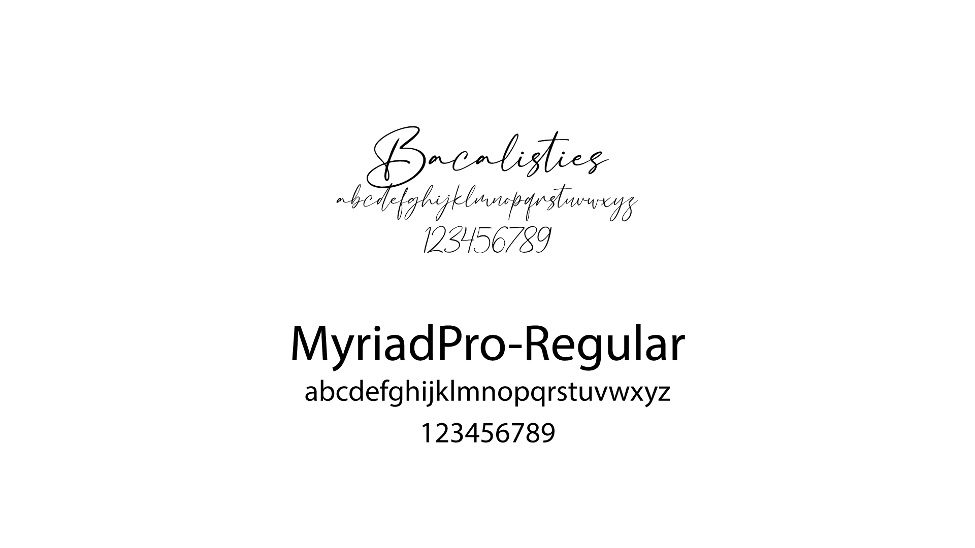
FONTS

Slide 12
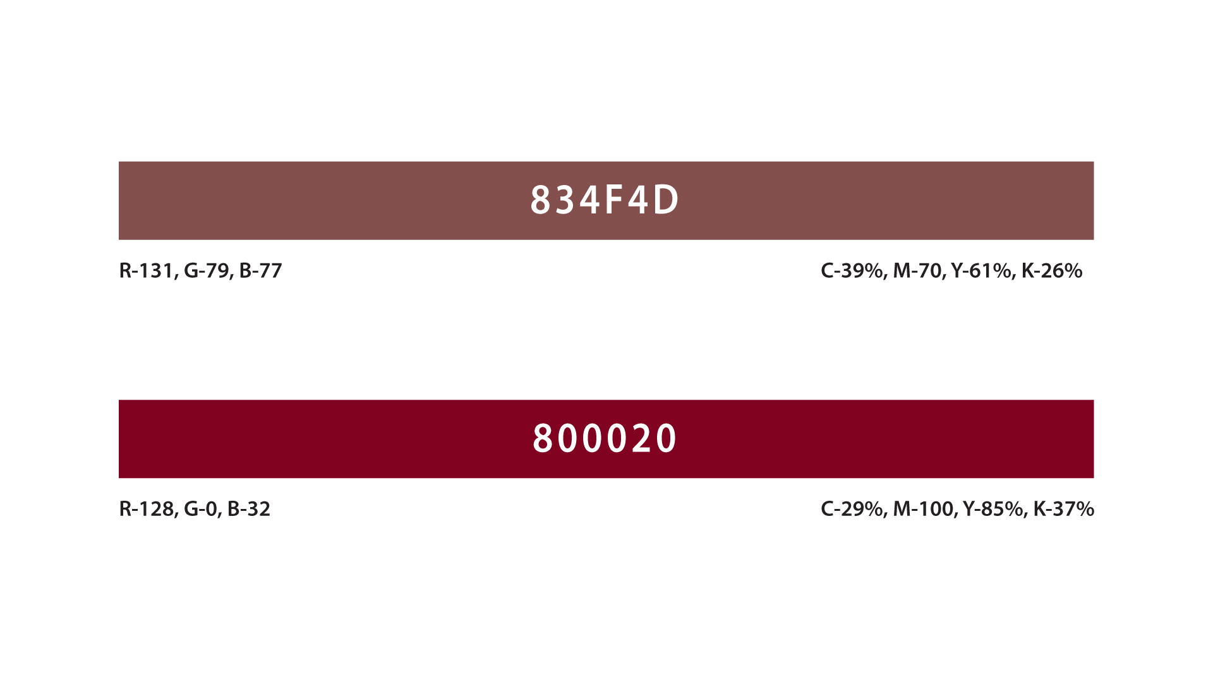
PRIMARY COLORS
These are the main two brand colors. The logo is to be used in this palette wherever possible.

Slide 13
END OF GUIDELINES

