Slide 1
BRAND GUIDELINES

Slide 2
INDEX
INTRODUCTION
IDENTITY SYSTEMS
VISUAL GUIDE
IMPLEMENTATION
Purpose
Brand Archetype
Brand Emotion
Logo Scaling - Vertical
Logo Spacing - Vertical
Logo Variation
Logo Placement
Logo Integrity “Don’ts”
Typography
Primary Color
Font Family
Email Signature
Envelope
Letterhead
Visiting Card
ID card
Lanyard

Slide 3
INTRODUCTION

Slide 4
PURPOSE
The purpose of a brand manual is to provide a comprehensive and standardized set of instructions and rules that define how a brand should be presented and represented across various mediums and platforms.
It serves as a reference document that ensures consistency, coherence, and uniformity in the way a brand is visually and verbally communicated to its audience, stakeholders, and the public.

Slide 5
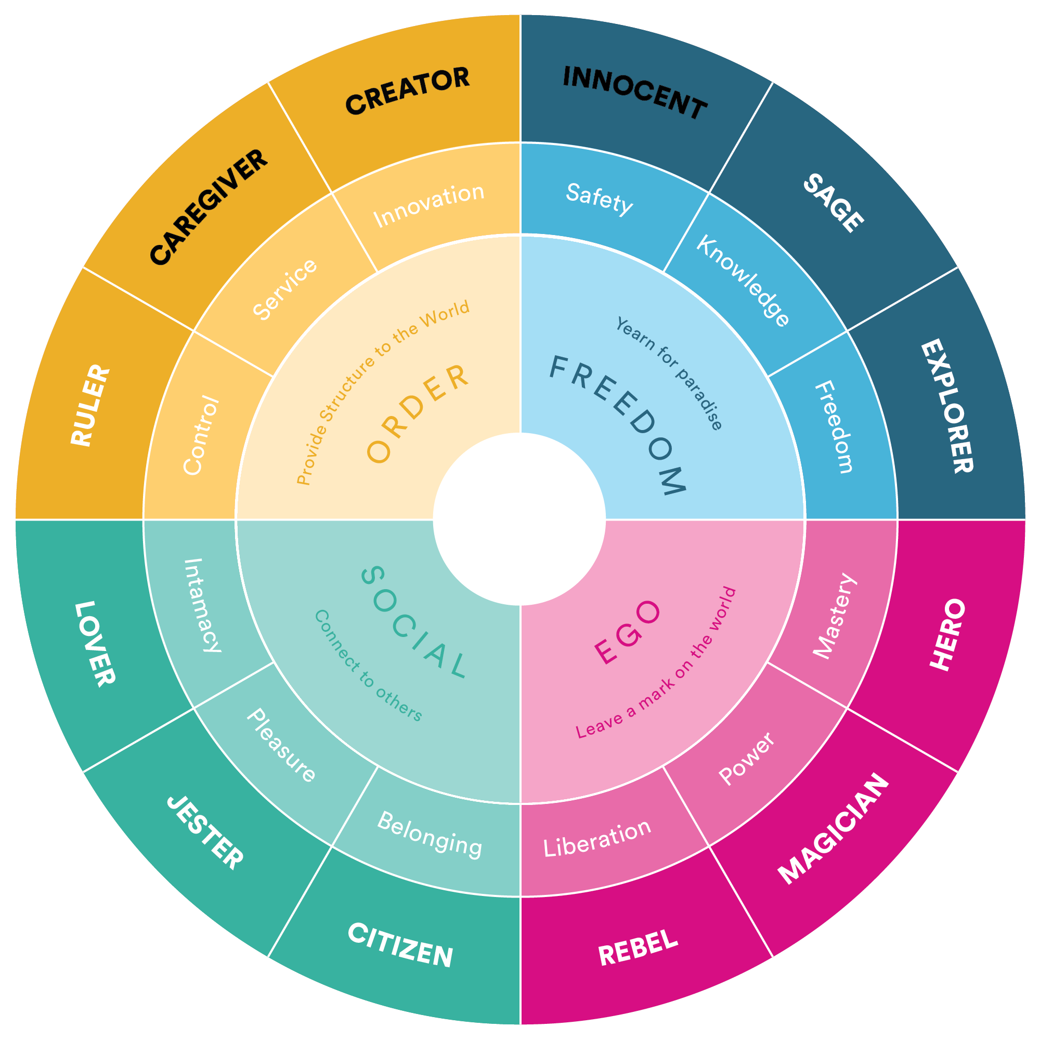
BRAND ARCHETYPE
Nurturing Innovator
OPDSure has a brand archetype by blending the characteristics of "The Caregiver," "The Creator," and "The Innocent." This archetype is called the "Nurturing Innovator."
The Nurturing Innovator: This brand archetype embodies a unique blend of nurturing, creativity, and optimism. The Nurturing Innovator brand is dedicated to fostering a sense of safety and care for its customers while encouraging innovative thinking.

Slide 6
BRAND EMOTION
OPDSure has the tagline of “Assured Health Partner”.
These 3 words come from the brand values focusing on being an assured health partner to employers and individuals.
The communication strategy aligned with the tagline "Assured Health Partner" should resonate with the key attributes of certainty, health focus, and collaboration.

Slide 7
IDENTITY SYSTEMS

Slide 8
LOGO REVEAL
Illustration
Typography

Slide 9
LOGO SCALING
4
2
7
Logo Proportion = 4:7
Logo Typography = 2:7

Slide 10
LOGO SPACING

Slide 11
LOGO VARIATIONS

Slide 12
SELECTED LOGO FORMATS
MOST PREFERRED FORMAT
ONLY FOR SELECTED COLLATERALS
MOST PREFERRED FORMAT
NOT TO BE USED

Slide 13
LOGO PLACEMENT (For Brand Communication)
4X
4X
X
X

Slide 14
LOGO PLACEMENT (For Stationery)
4X
4X
X
X

Slide 15
LOGO USAGE - DON’T
Do not use any other color in the background.
Do not change the colors of the logo.
Do not squeeze the logo.
Do not change the oapacity of the logo.
Do not use complicated backgrounds.
Do not rotate the logo.
Do not use any effects on the logo.
Do not change the position of the logo elements.

Slide 16
VISUAL GUIDE

Slide 17
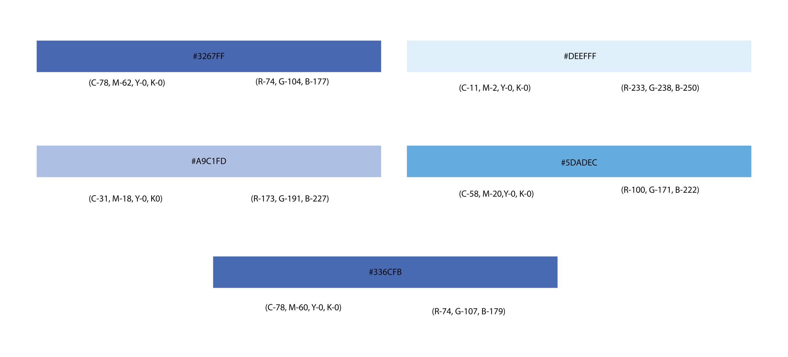
PRIMARY COLORS
These are the main five brand colors. The logo is to be used in this palette wherever possible.

Slide 18
FONTS

Slide 19
IMPLEMENTATION

Slide 20
Email Signature

Slide 21
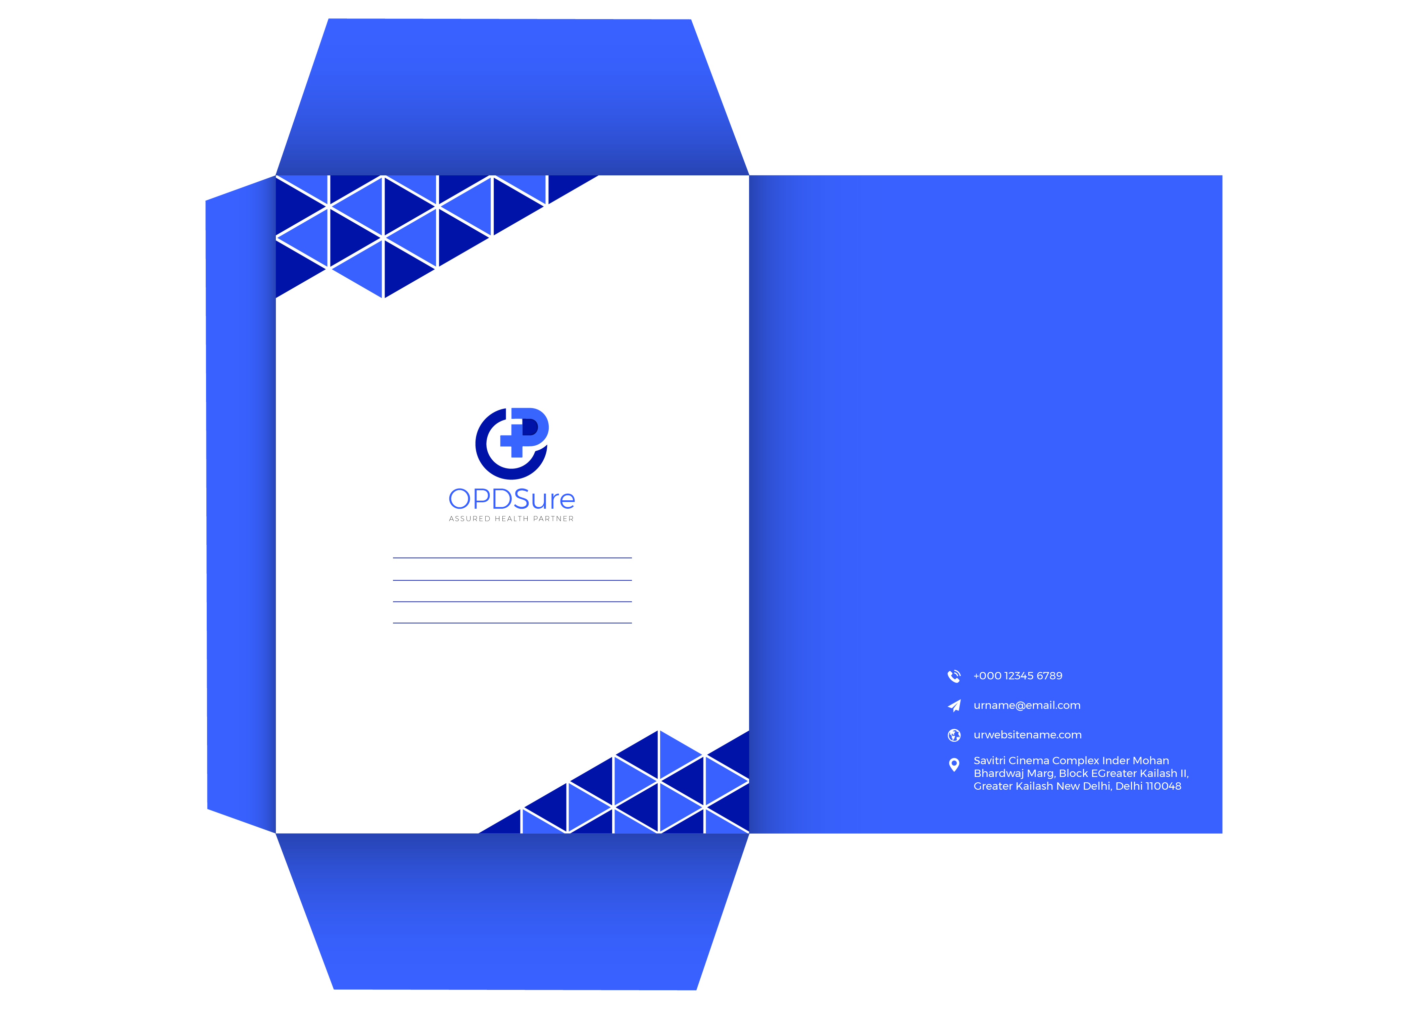
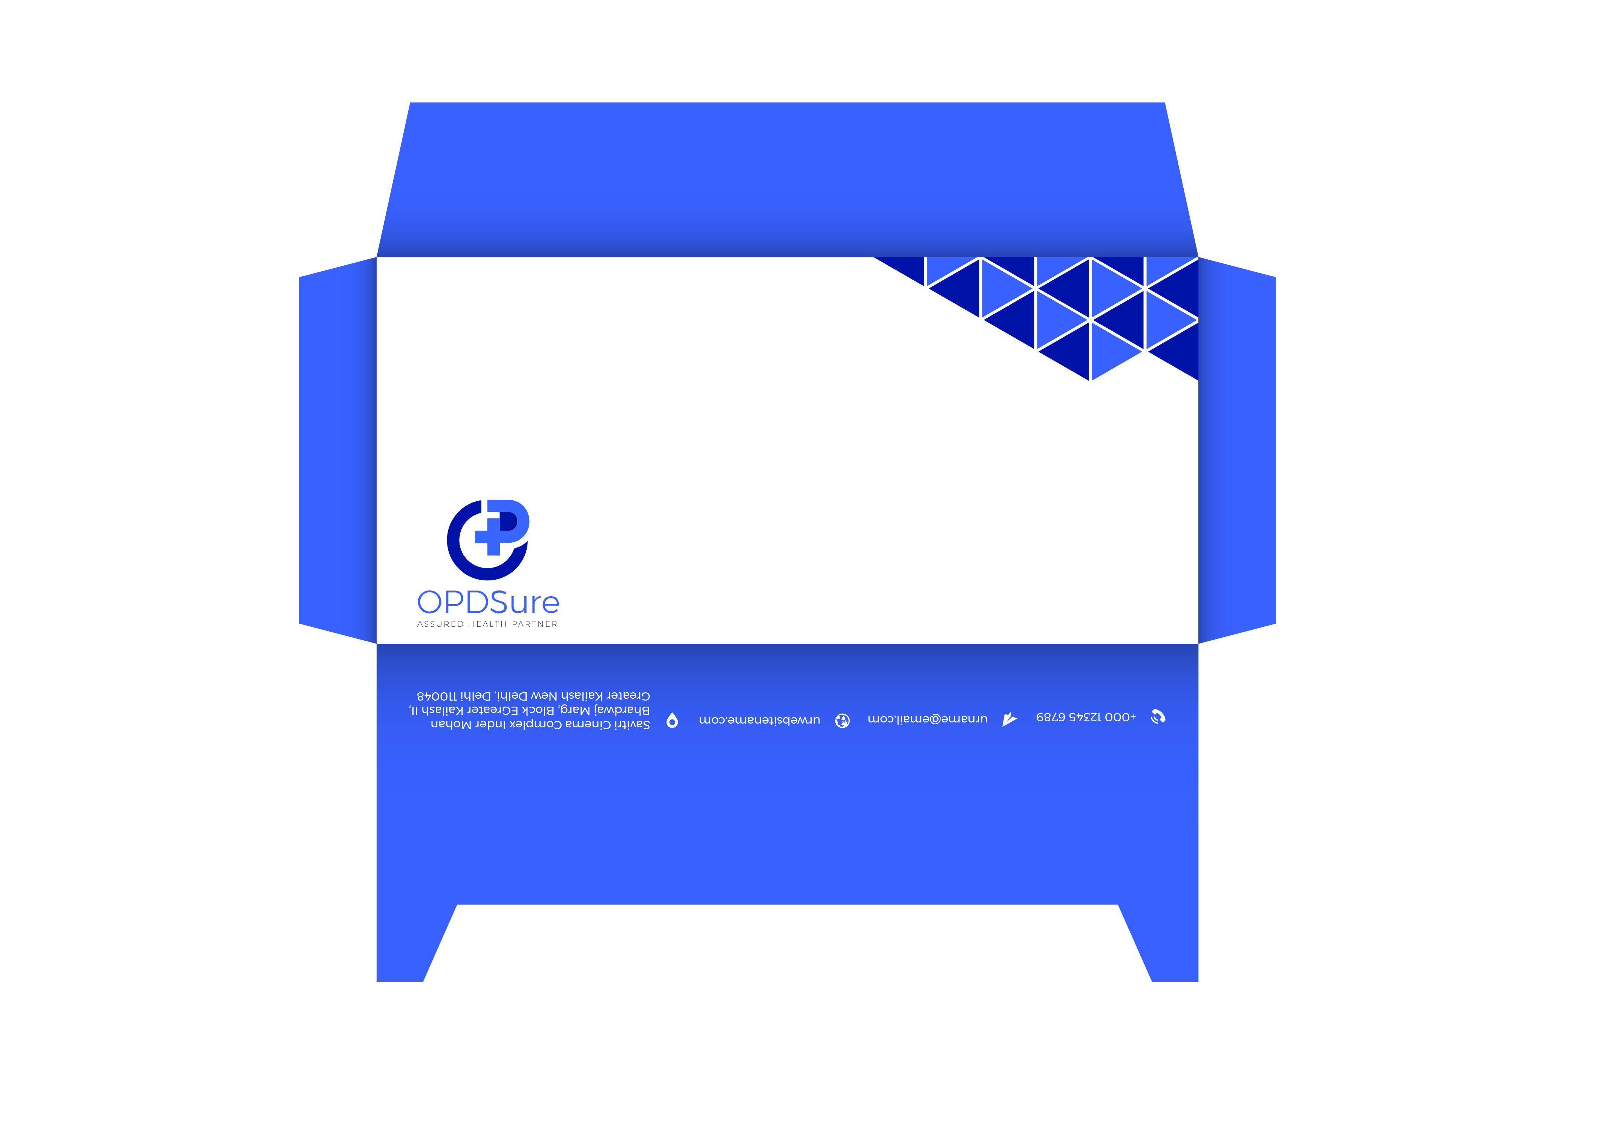
Envelope

Slide 22
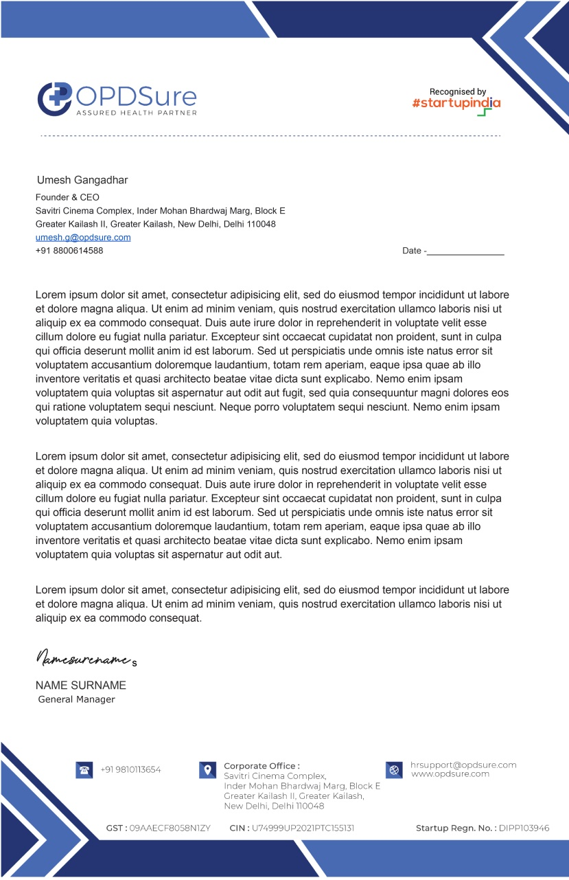
Letterhead

Slide 23
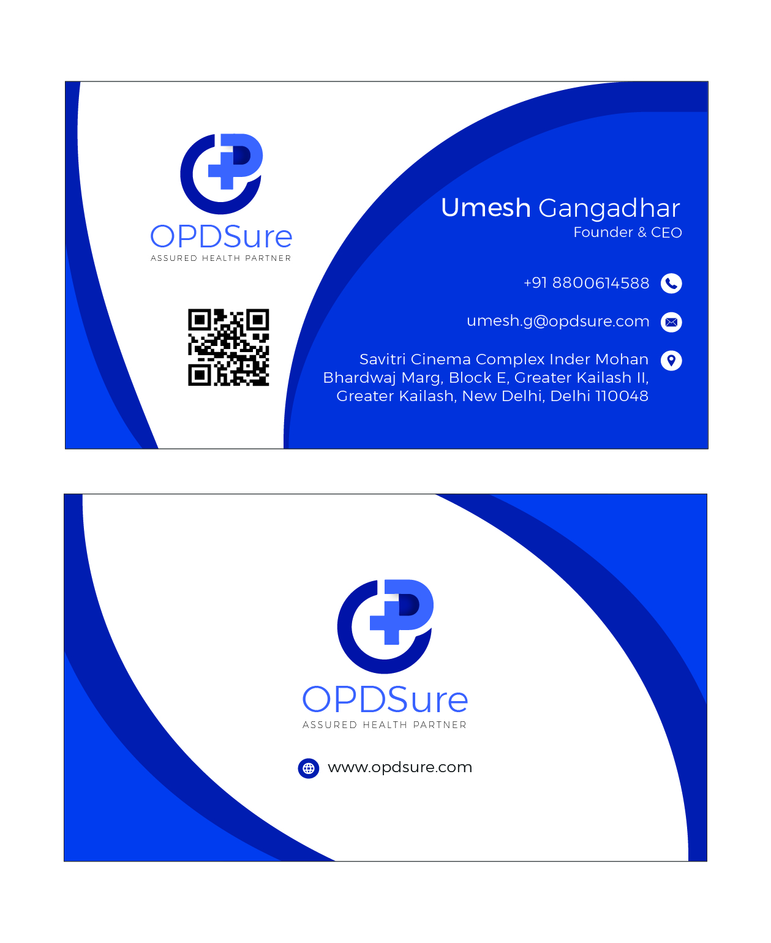
Visiting Card
d

Slide 24
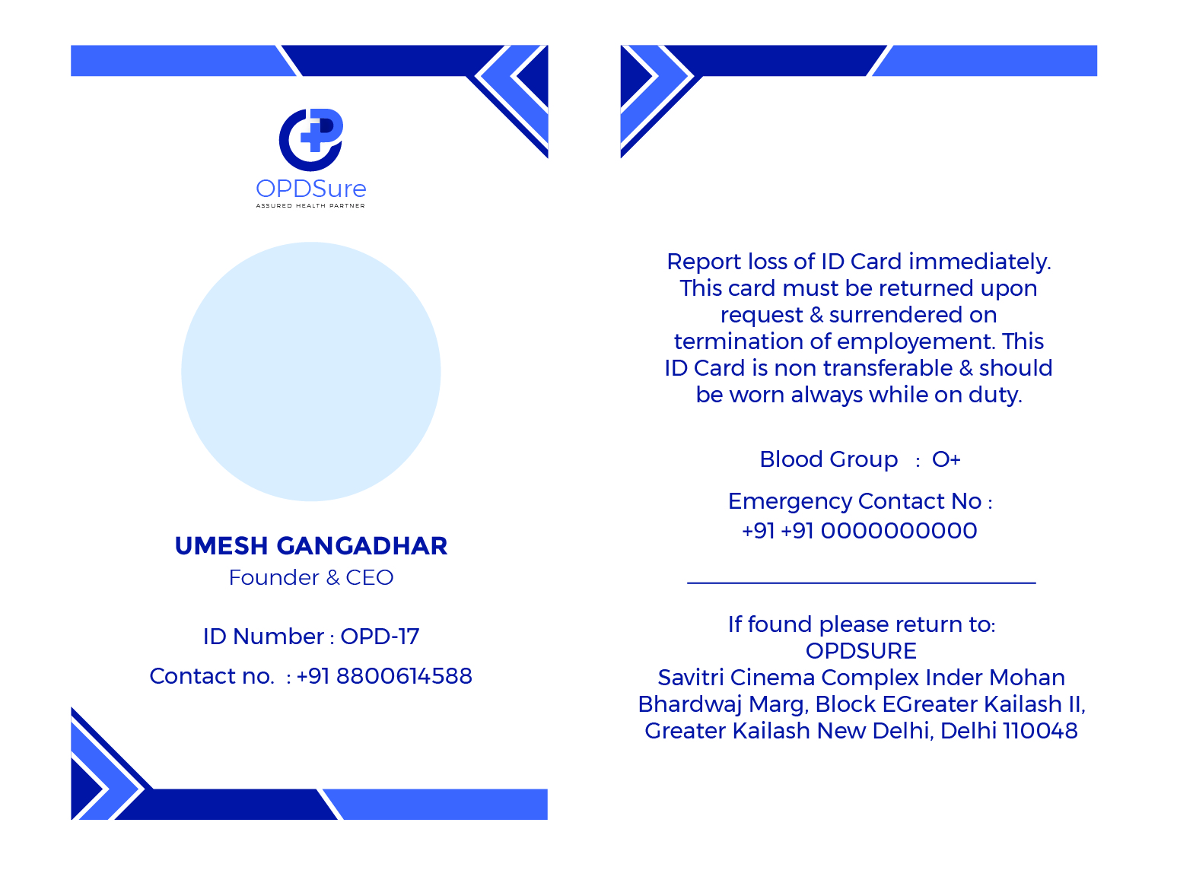
ID Cards

Slide 25
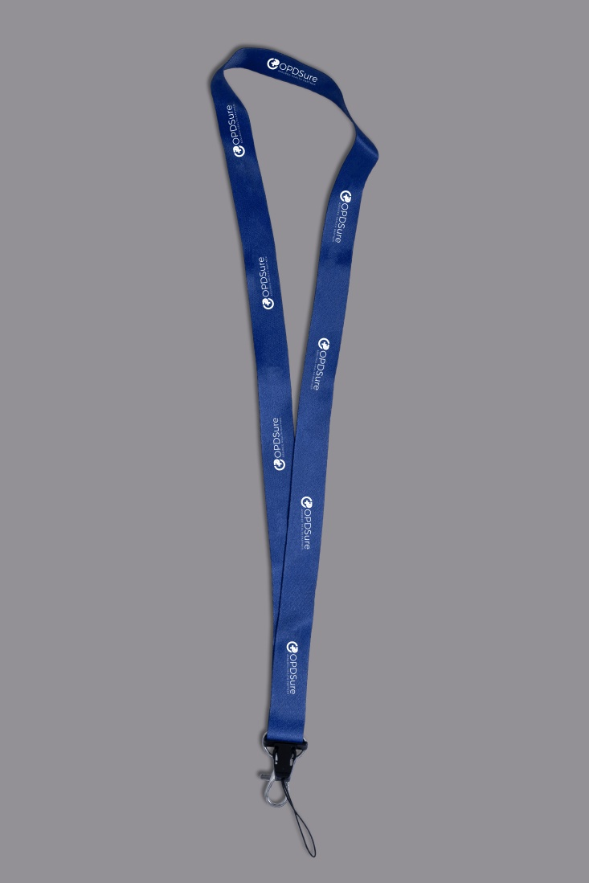
Lanyard

Slide 26
Notepad

Slide 27
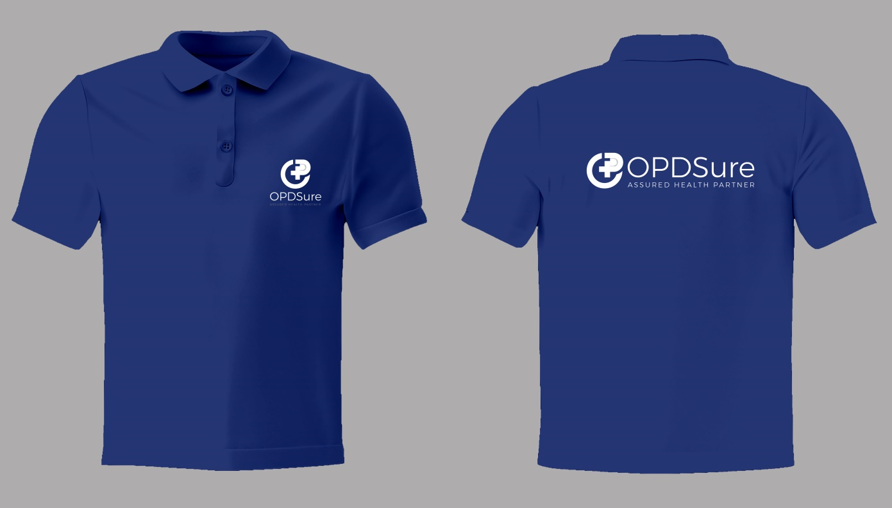
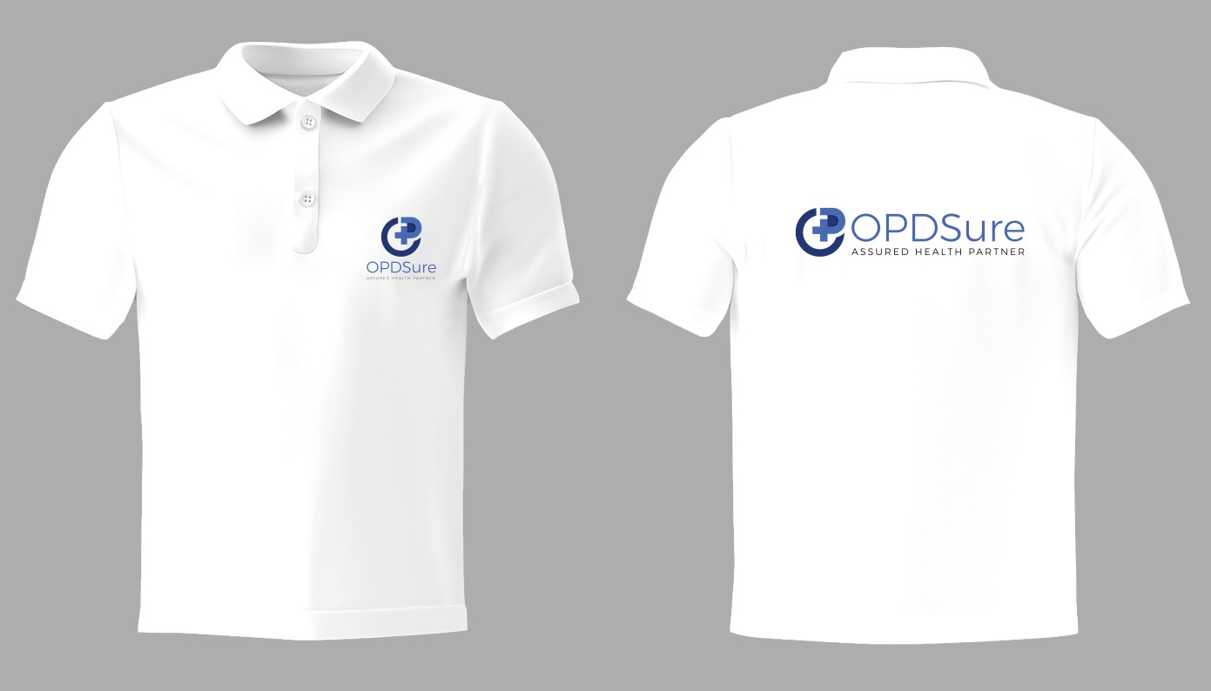
T shirt

Slide 28
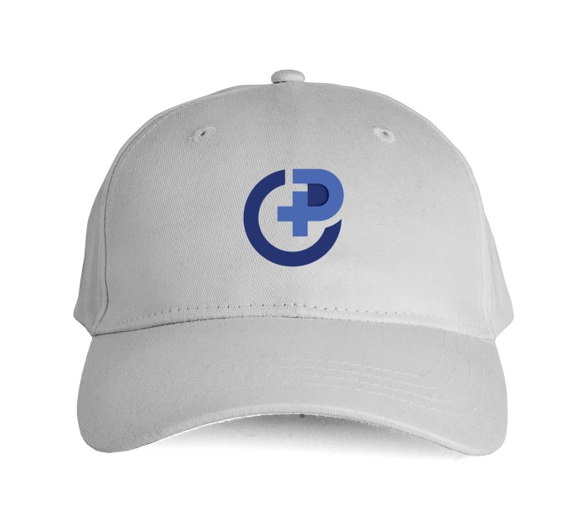
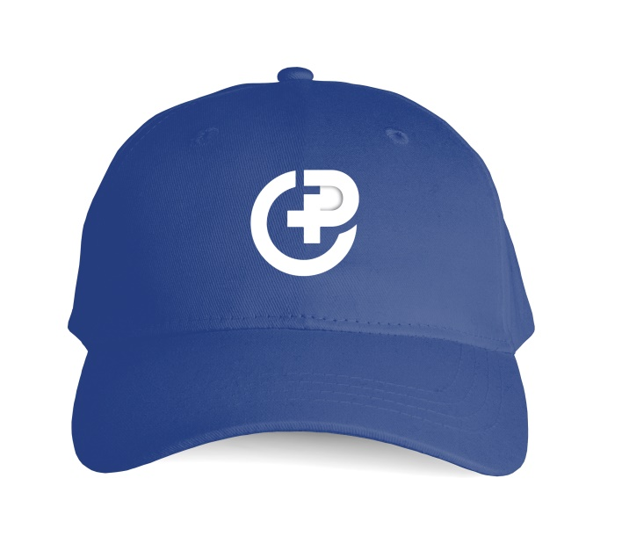
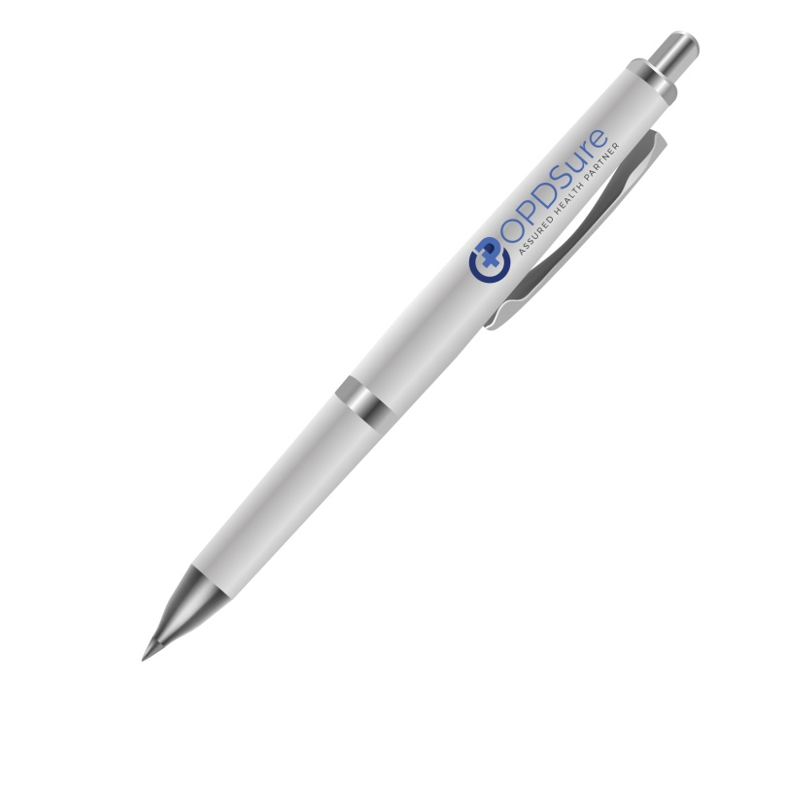
Pen, Cap, Mask

Slide 29
END OF GUIDELINES

